Slide 1
Empower Your Team with ChatOps: Getting Started with PoshBot
- Andrew Pla

Slide 2



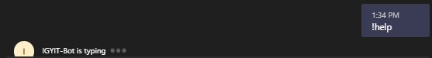
Who Am I?
Systems Engineer working out of Gainesville, FL ☀️
Co-founder of the GNVPSUG
Blog: https://AndrewPla.Github.io
@AndrewPlaTech
https://github.com/AndrewPla
Notes:
Using PoshBot at work since the Teams backend was developed a year ago.
Examples today will show a mixture of Teams and Slack
Developed a couple PoshBot modules and extended the Teams backend to support sending a typing indicator.
Does anyone perform the same tasks daily? Checking on script from previous day, checking on infrastructure, Query databases?

Slide 3

Agenda
What is ChatOps?
PoshBot Overview
Examples
Starting your ChatOps journey

Slide 4
What is Chatops?
“We’re bringing in the work that you’re already doing, in line with the context of the conversations that you’re already having”
-James Fryman
“ChatOps is a collaboration model that helps to connect people, process, tools, and automation into a transparent workflow.”
-Atlassian
Notes:
ChatOps isn’t a technology, it’s more of a methodology.
DevOps is a software engineering culture and practice that aims at unifying software development and software operation. The main characteristic of the DevOps movement is to strongly advocate automation and monitoring at all steps of software construction, from integration, testing, releasing to deployment and infrastructure management

Slide 5
ChatOps
Tools that you already use, but in chat
Automation taking place alongside communication
“everyone is pairing all of the time” – Jesse Newland

Slide 6

Social Benefits
Increased Collaboration
Exchange Knowledge
Cultural
Empathy
Shorter Feedback Loops
Empowerment
Notes:
Increased Collaboration: The sum is greater than the parts. 2 heads is better than one.
Searchable Log of All Communication and Knowledge
Define a culture of automation, empathy, and collaboration
Empathy – “Has anyone here ever been asked by a coworker to get something done when you were already working on something?” Increasing the visibility of work performed causes people to understand what is going on and hopefully understand that their request can’t be completed yet.
Shortened feedback loops
Less email
Empower people to solve issues themselves. People are able to solve their own issues and educate themselves

Slide 7
Technical benefits
Automation
Shared CLI
Common Interface
Logging
Security
Distribution
Notes:
Automation is awesome and a net positive for your org
Shared CLI Commands run and results are shared. Useful for troubleshooting as it provides a shared context.
Logging: centralized logging and 1 server to secure
Security: Run poshbot as an unprivileged account and pass it credentials with the minimum permissions required. Add additional Validation to commands as well.
Distribution is simple

Slide 8

Examples
Check/Restart Services
Return server configuration
Manage tickets
Deploy software
Interact with APIs
Provision new VMs
Query databases
Check on currently automated processes
Anything you can imagine (almost)

Slide 9

Make your job easier
Less people ask you questions
Work from your phone
Share your tools much easier
Rely on other SME to create tools
Encourage automation
Have more fun
Notes:
Less questions – more work done
Working from phone is just awesome
Share your tools much easier. Get a higher ROI for your toolmaking.

Slide 10





Chatbots
Hubot – CoffeeScript or JavaScript
ErrBot - Python
Lita – Ruby
Cog – extensible
Poshbot - PowerShell

Slide 11

What is Poshbot
PowerShell-based chat bot framework
Role Based Access Control
Plugins (PowerShell Modules)
PowerShell jobs
Goal: Create a first-class experience for PowerShell developers
Created by Brandon Olin @DevBlackOps

Slide 12



PoshBot Backends
Slack
Teams
Google Chat - PoshBot.GChat.Backend
Notes:
Discord is coming soon

Slide 13
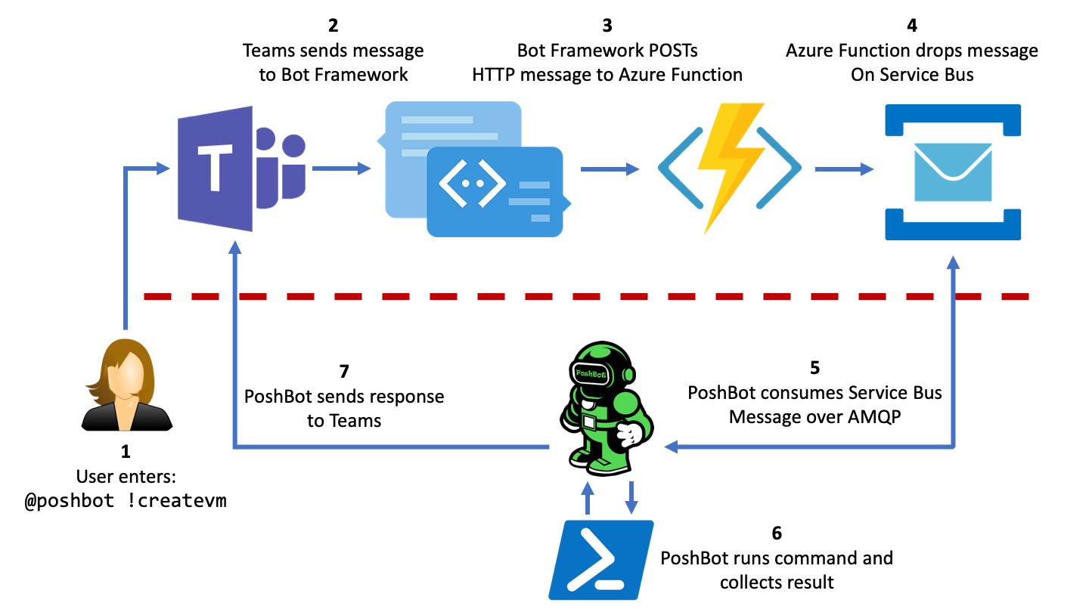
Teams BAckend
https://poshbot.readthedocs.io/en/latest/guides/backends/setup-teams-backend/

Slide 14
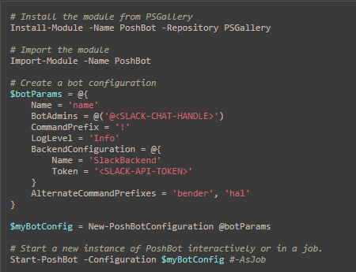
Running slack
https://poshbot.readthedocs.io/en/latest/guides/quickstart/#quickstart
Notes:
Register a bot in slack and then get the SLACK API Token

Slide 15
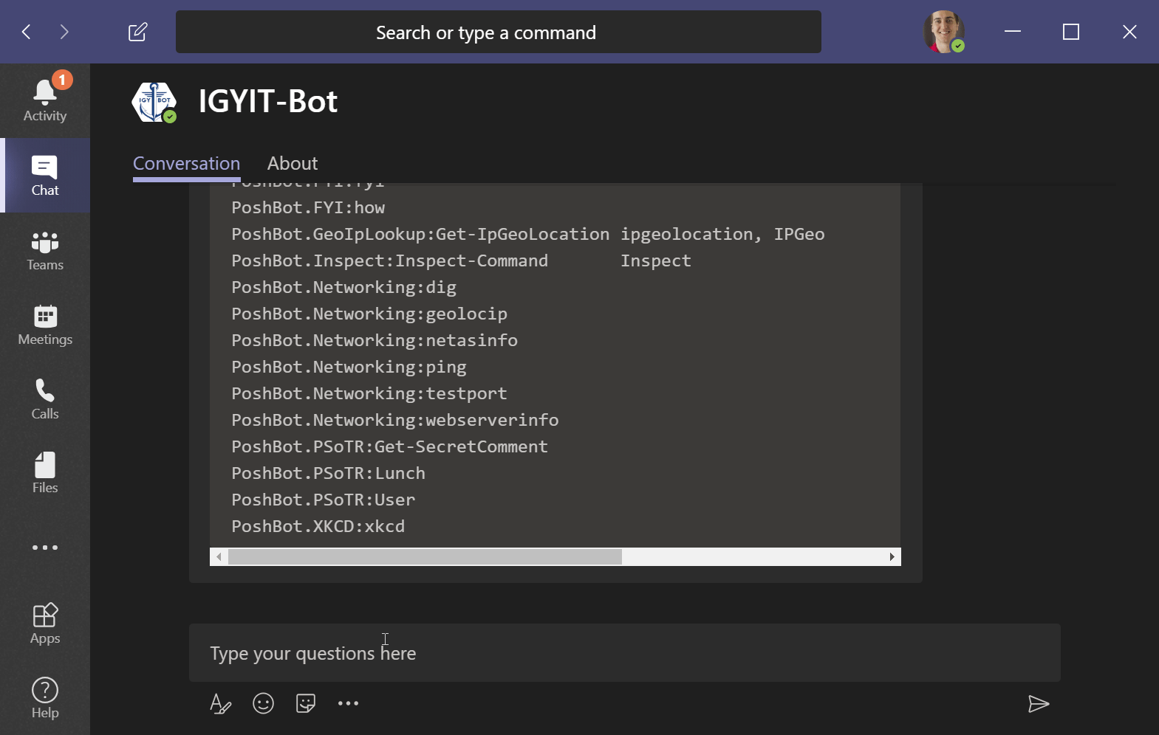
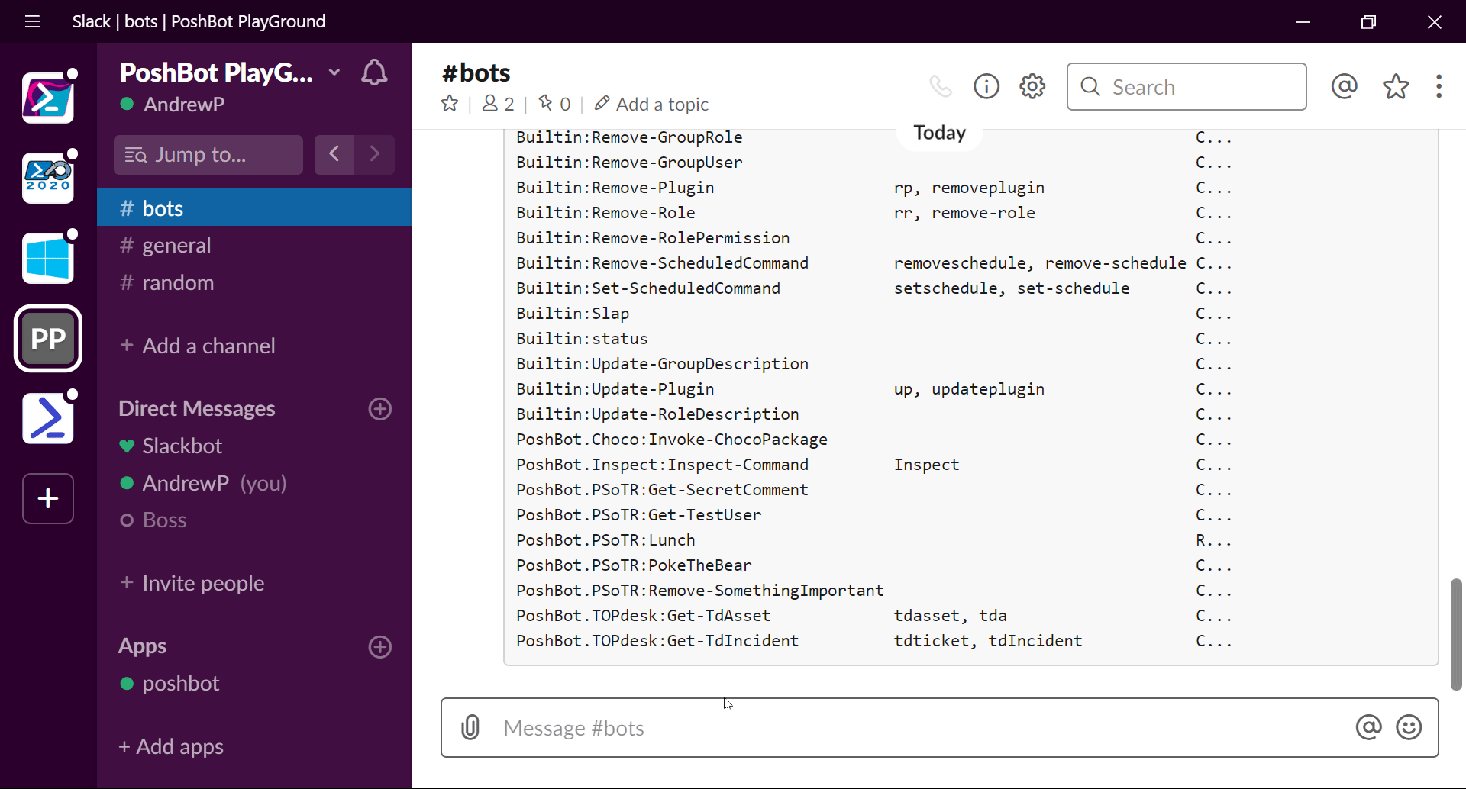
!Help

Slide 16

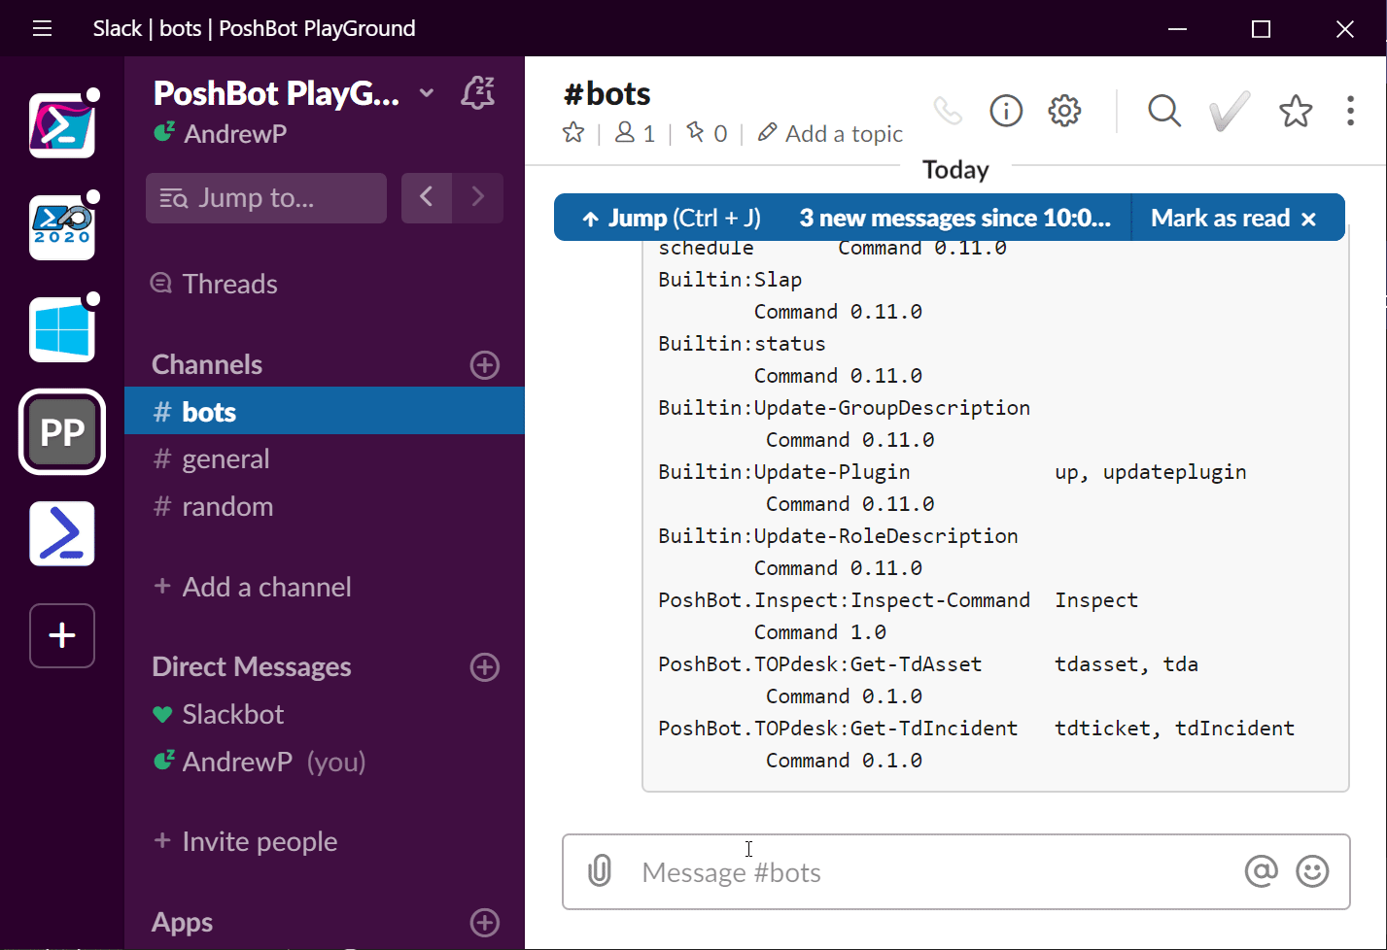
!Help Slap
Notes:
How does one go about slapping users appropriately

Slide 17
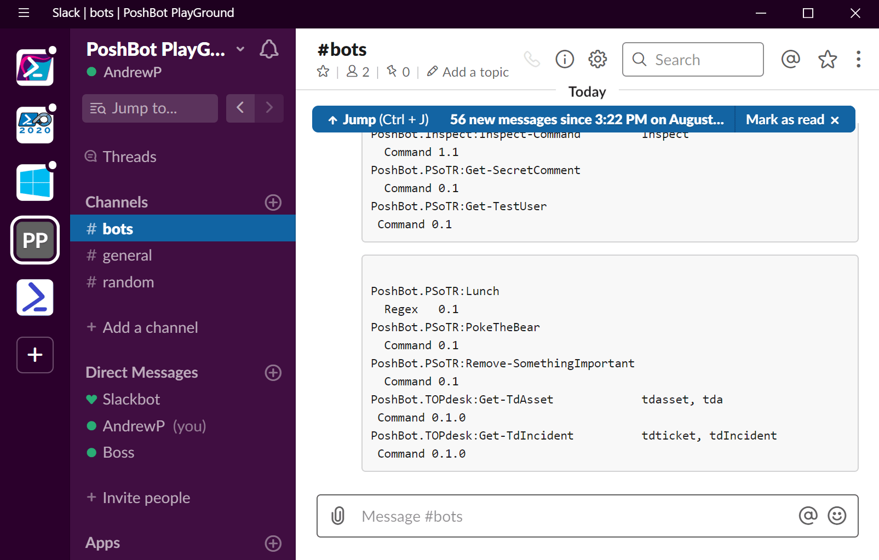
Check Status

Slide 18
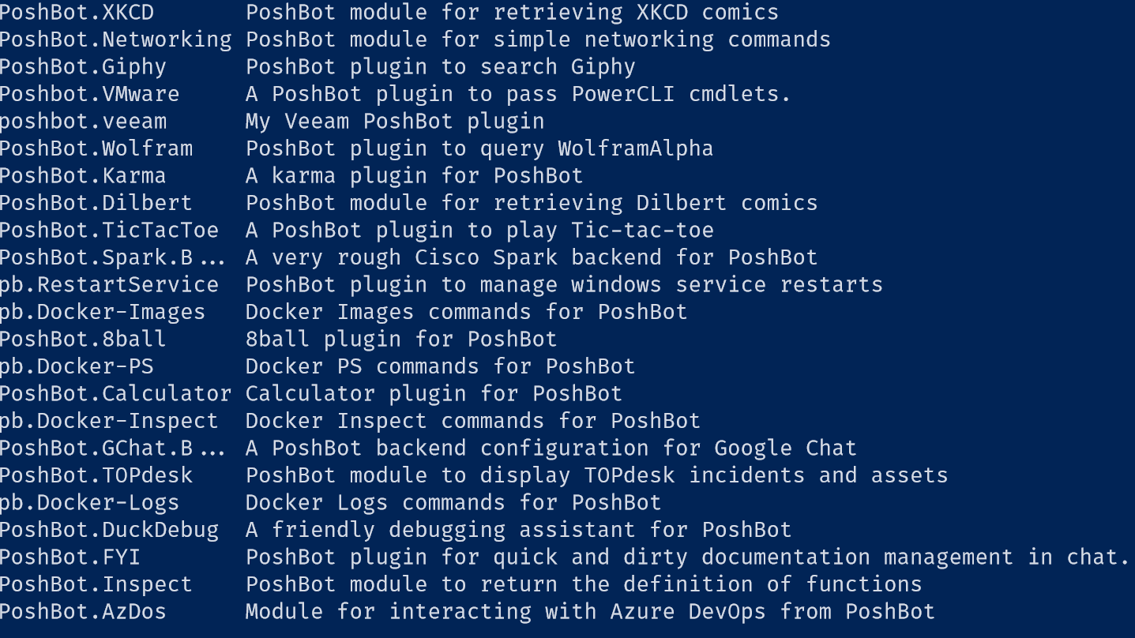
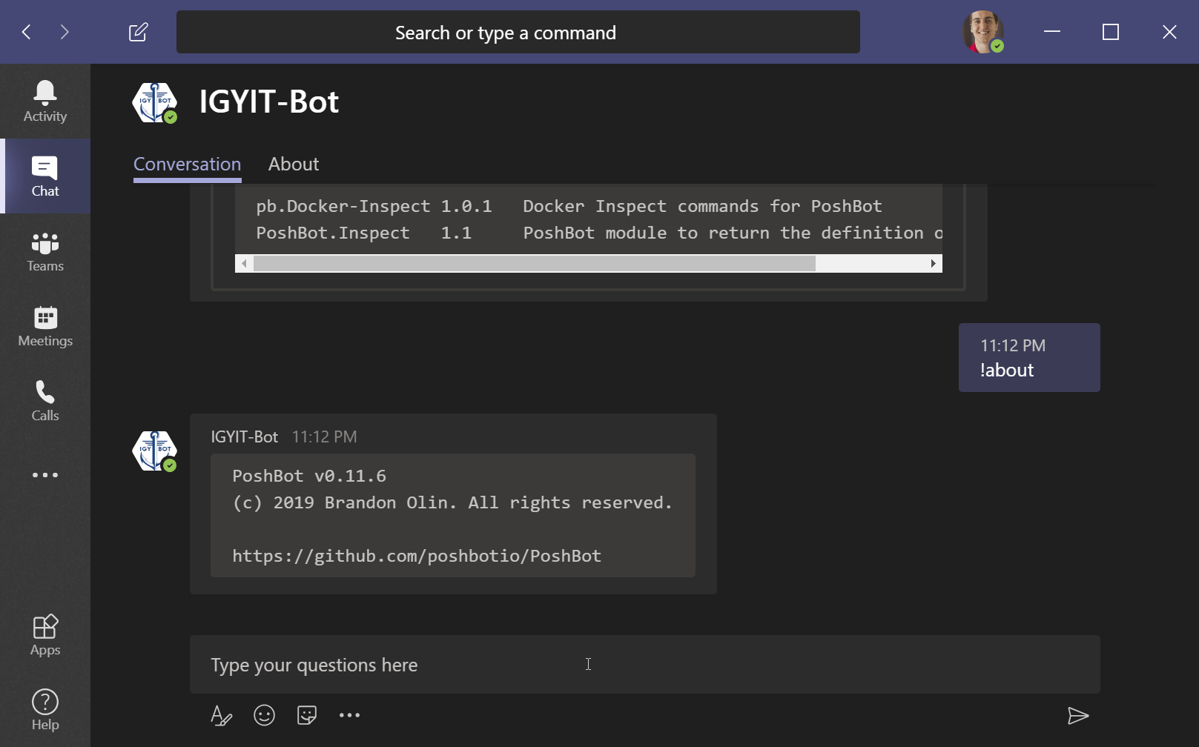
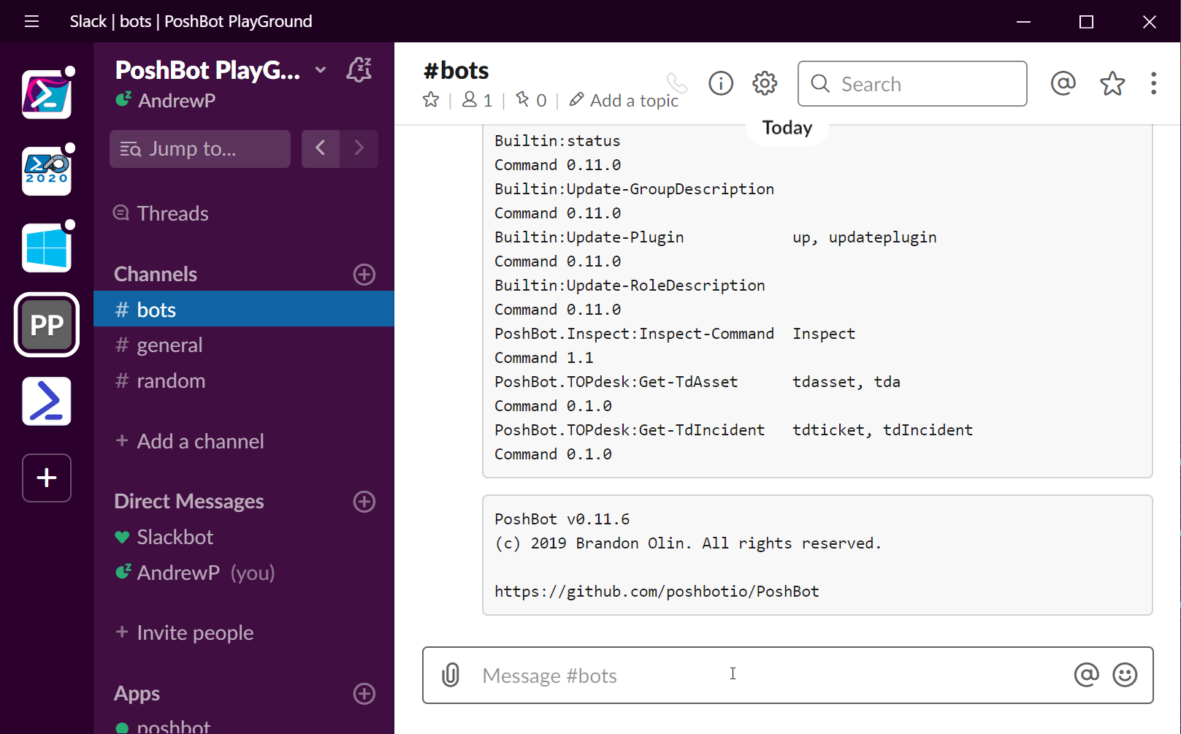
Find Plugins

Slide 19
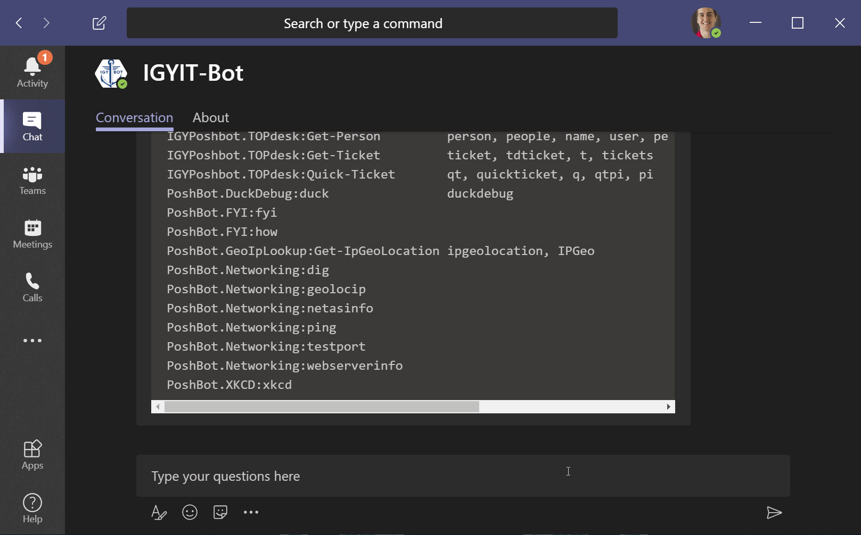
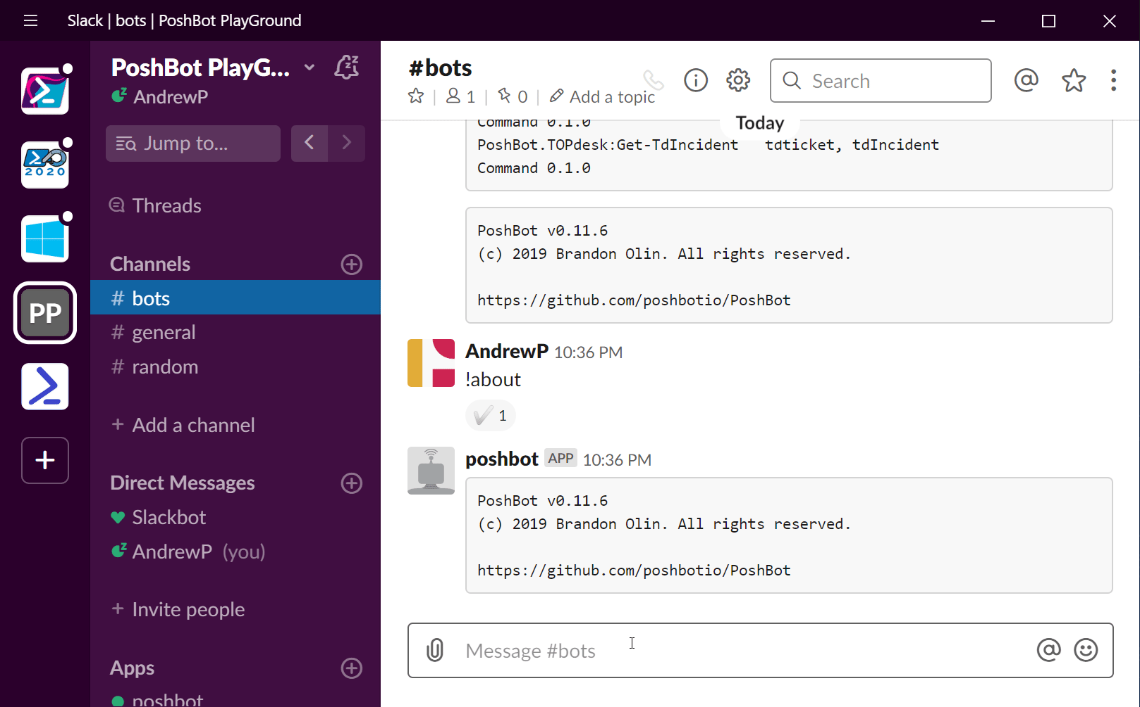
Install Plugins

Slide 20
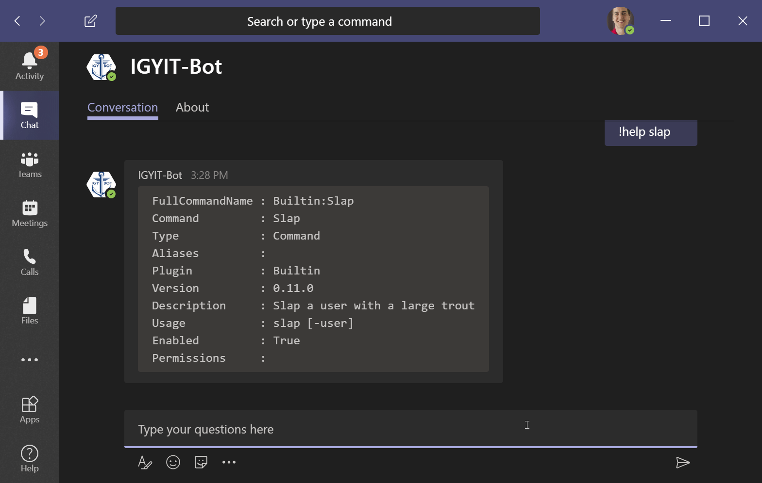
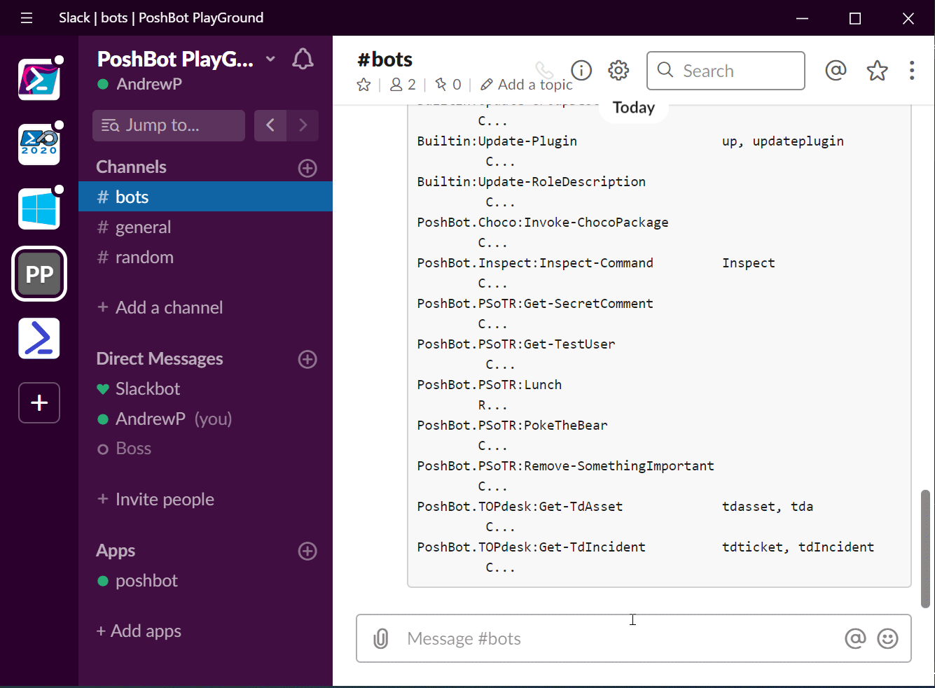
!Help Inspect-Command
Notes:
We want to increase visibility into what code is being run. Inspect-Command takes the function definition and displays it. Your team doesn’t need to install any module on their machine in order to look at the code that will be run when you execute a bot command.
More transparency = good!

Slide 21
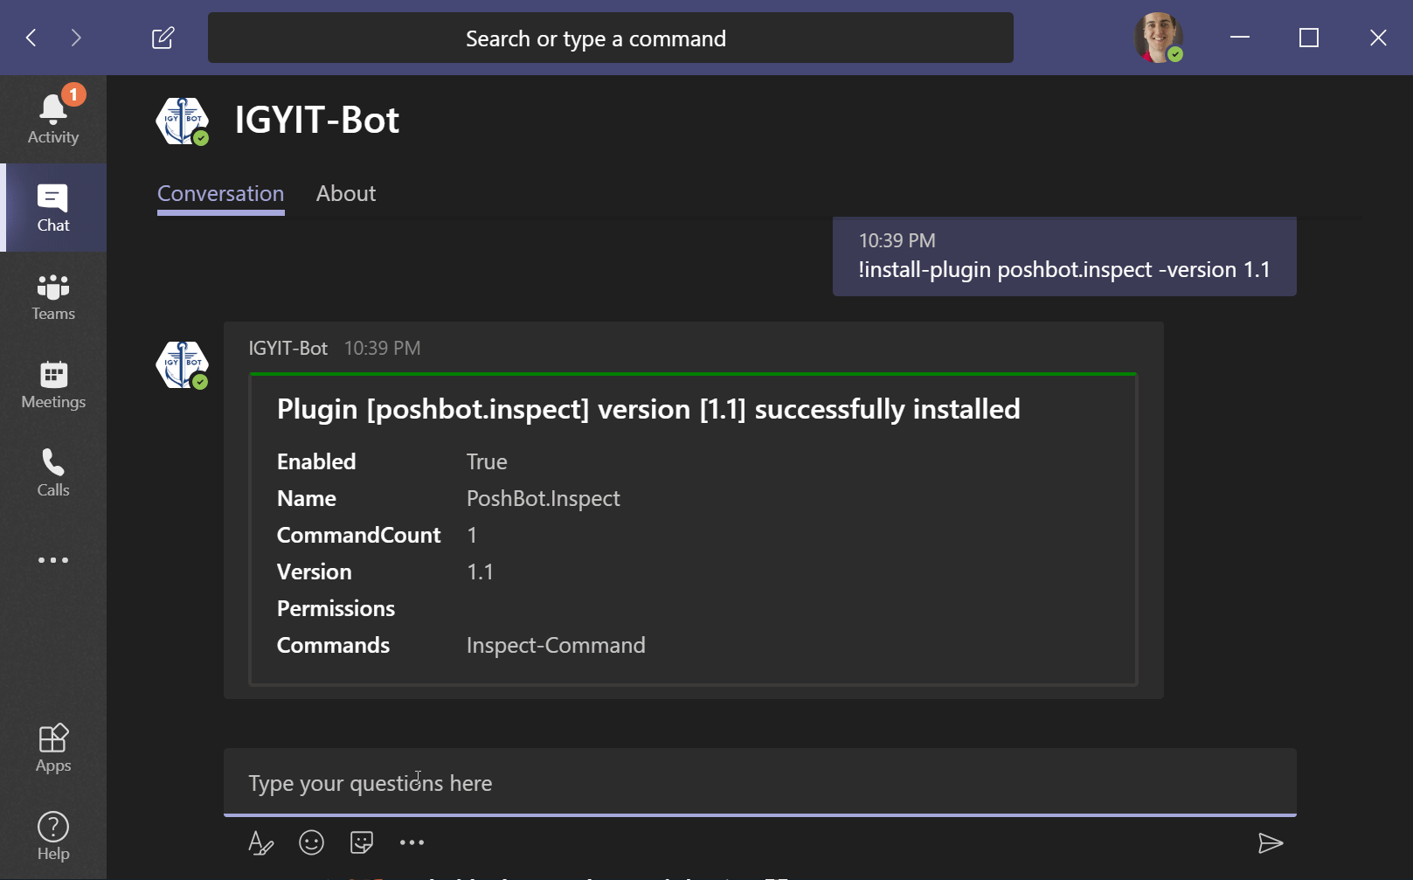

!Inspect-Command Slap
Notes:
There’s a bug, it doesn’t display the comment based help in Teams. Anyone wanna fix it?

Slide 22
Triggers
Command
Event (Slack Only)
Regex

Slide 23
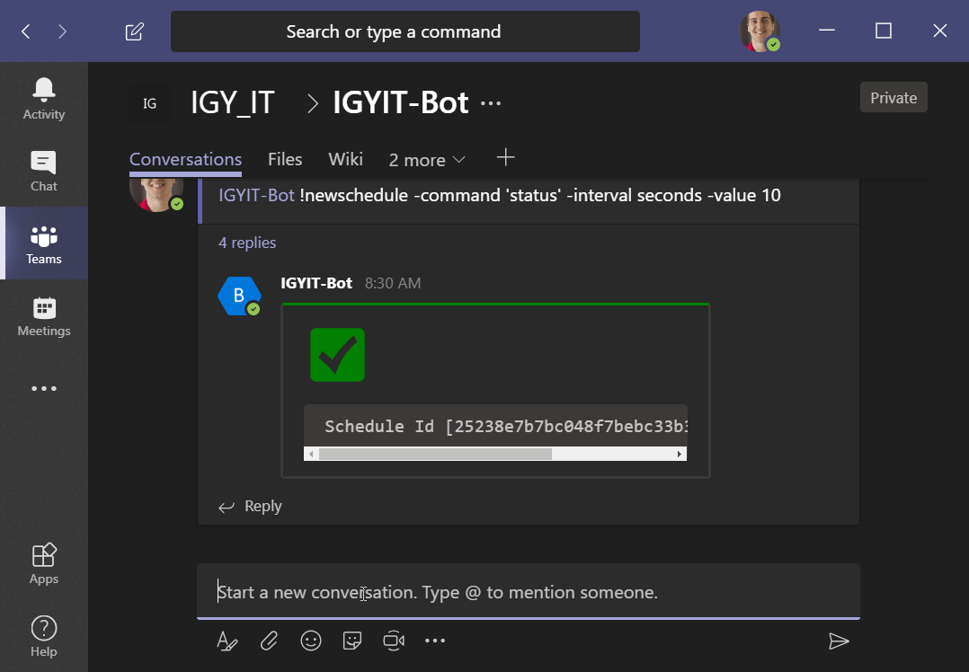
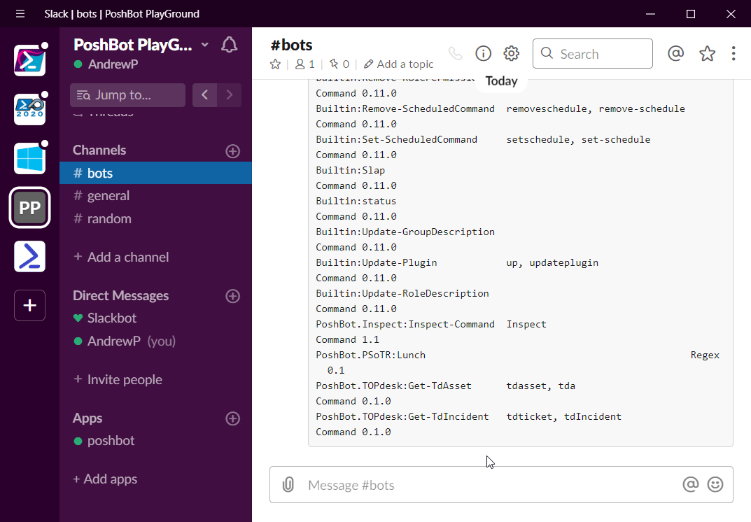
Command Trigger
Notes:
Default trigger type
Teams only responds via dms or when it is explicitly @mentioned in a channel.

Slide 24
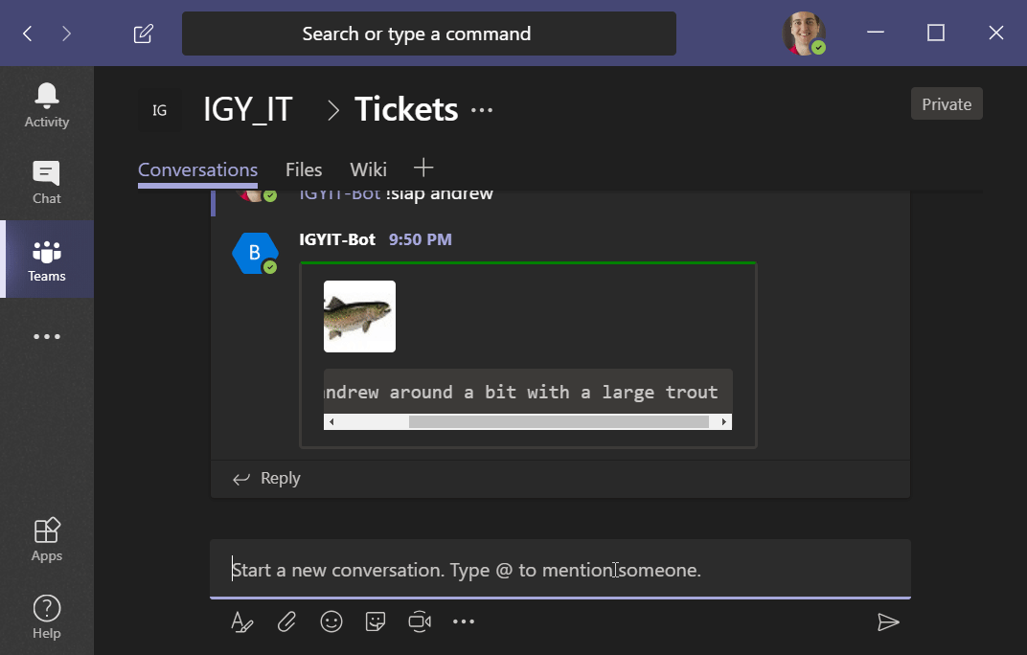
Did somebody mention teams?

Slide 25
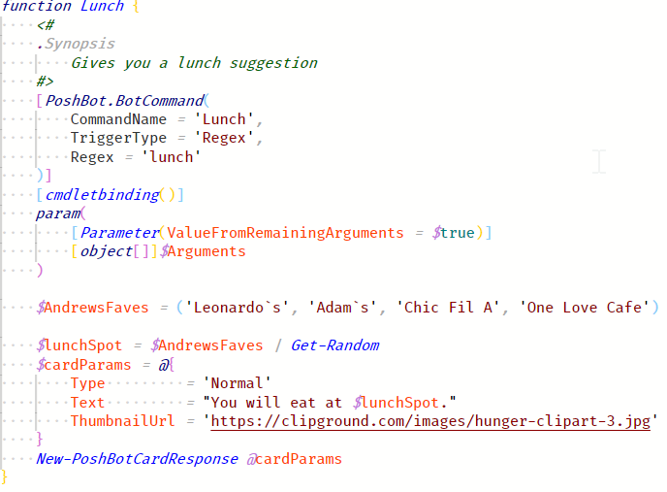
Regex Trigger

Slide 26
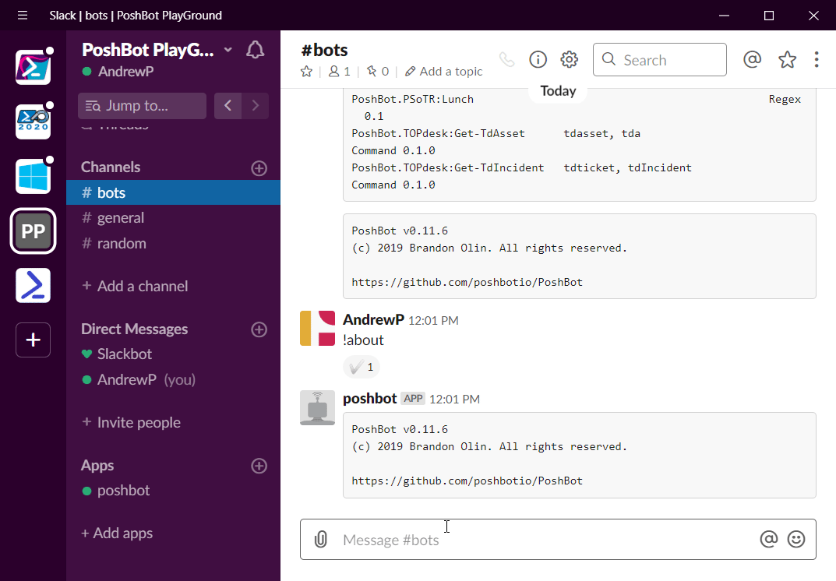
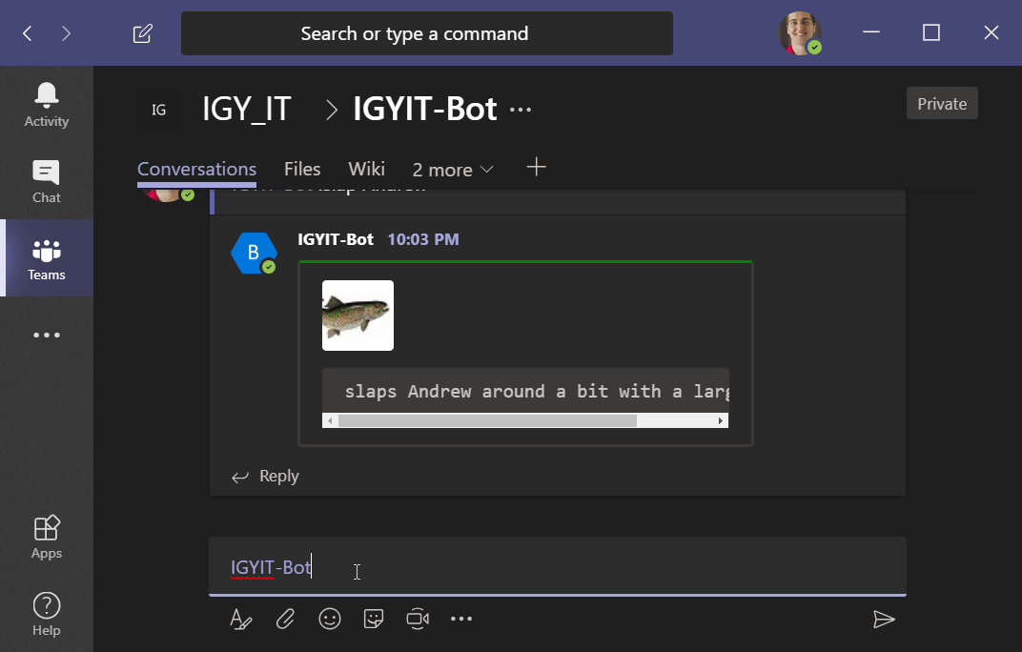
Lunch

Slide 27
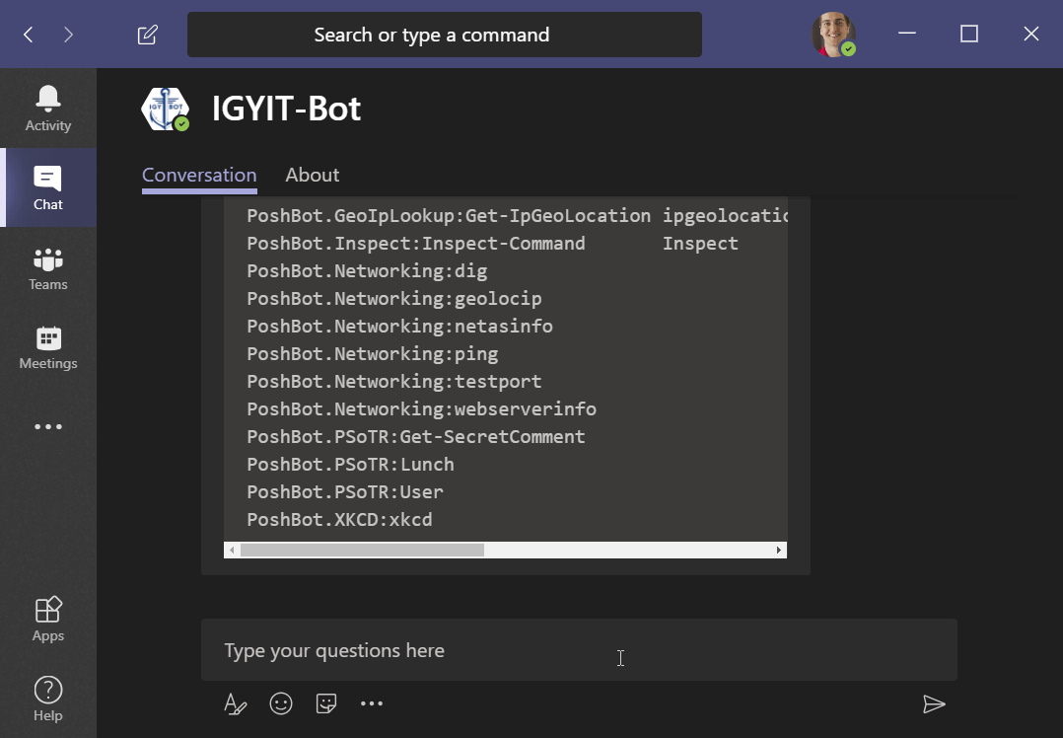
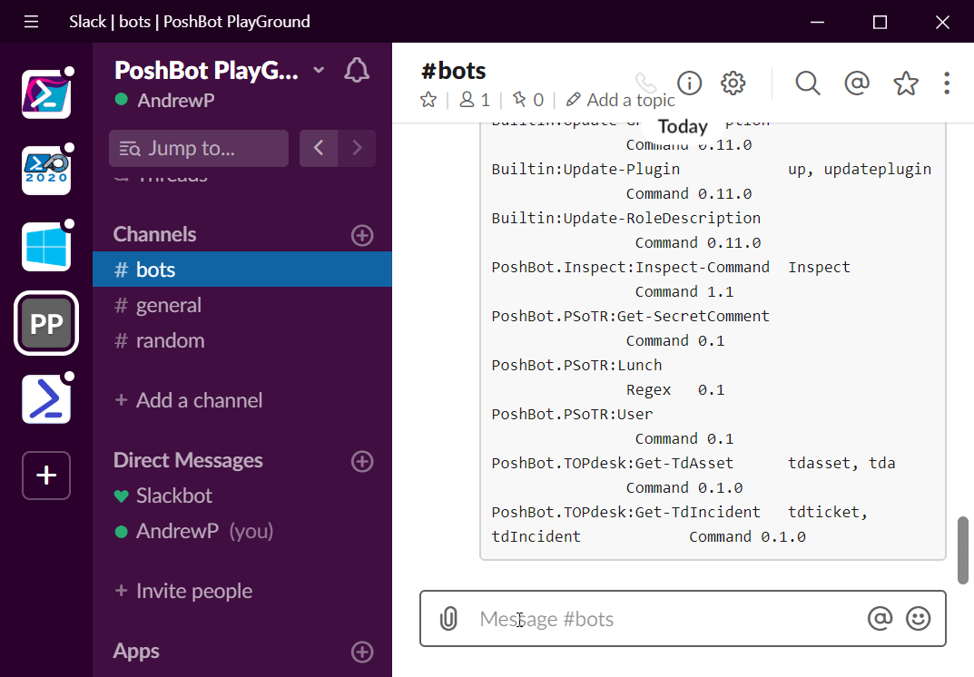
Permissions
Notes:
You don’t want everyone able to run everything. What if you have some pretty

Slide 28
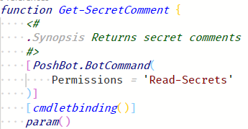
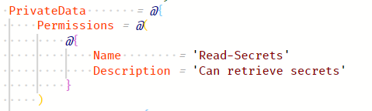
Permissions
Module manifest (.psd1)
[PoshBot.BotCommand] Attribute
Notes:
Permissions for commands go into the privatedata of the module manifest .psd1 file
In the PoshBot.BotCommand attribute of a command we are able to set the permissions

Slide 29
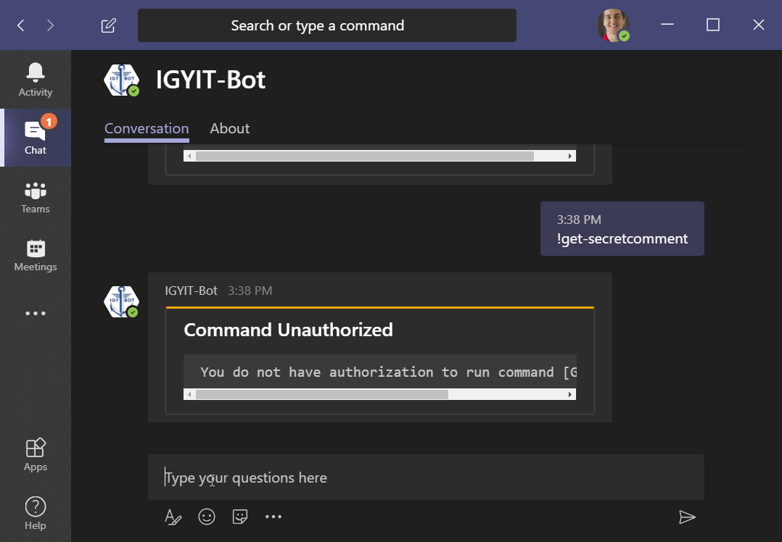
Return Permissions

Slide 30
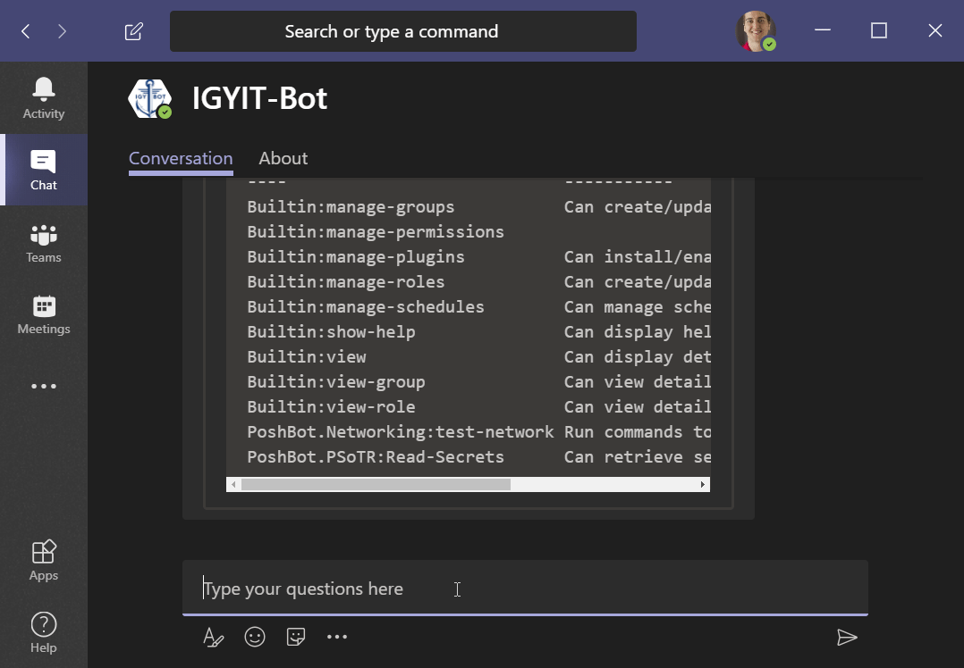
New-Role
Notes:
Now we need to create a role that we will assign the ‘Read-Secrets’ permission to.
Now we have a role without permissions assigned to it.

Slide 31
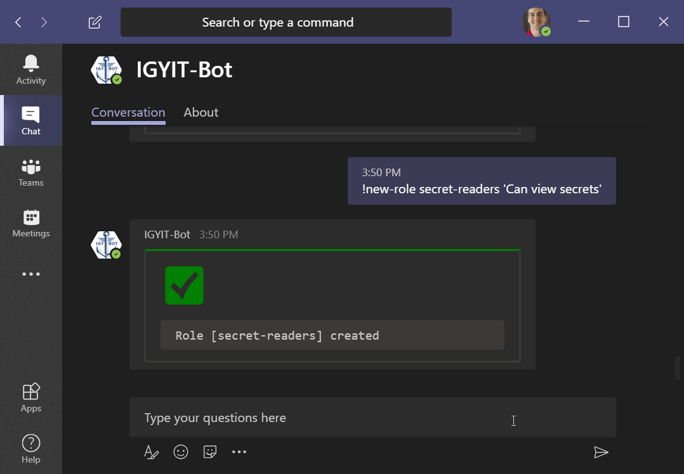
Add-RolePermission

Slide 32
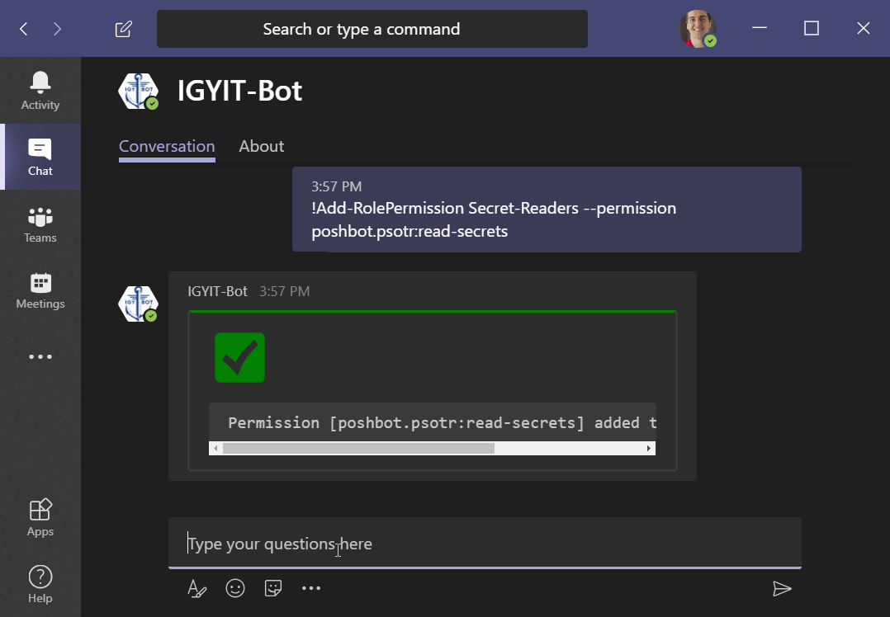
Add-GroupRole
Notes:
I’m a member of the admin group already and want admins to be able to return secrets.

Slide 33
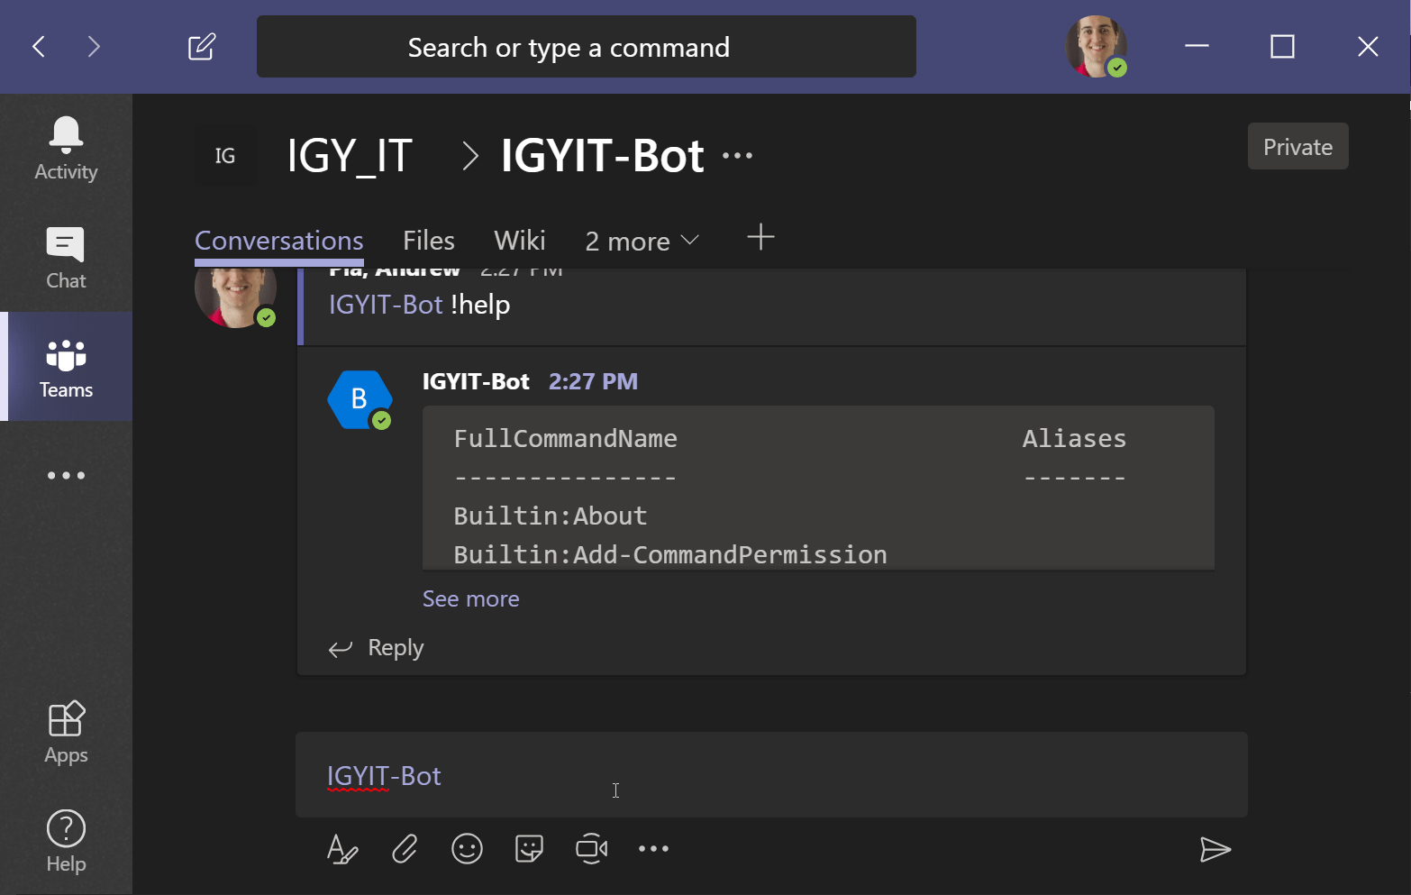
Get Secrets
Notes:
Now we can run the command, but wait! We are in a channel that has non admins. We don’t want to expose these secret comments to everyone, right? RIGHT?

Slide 34
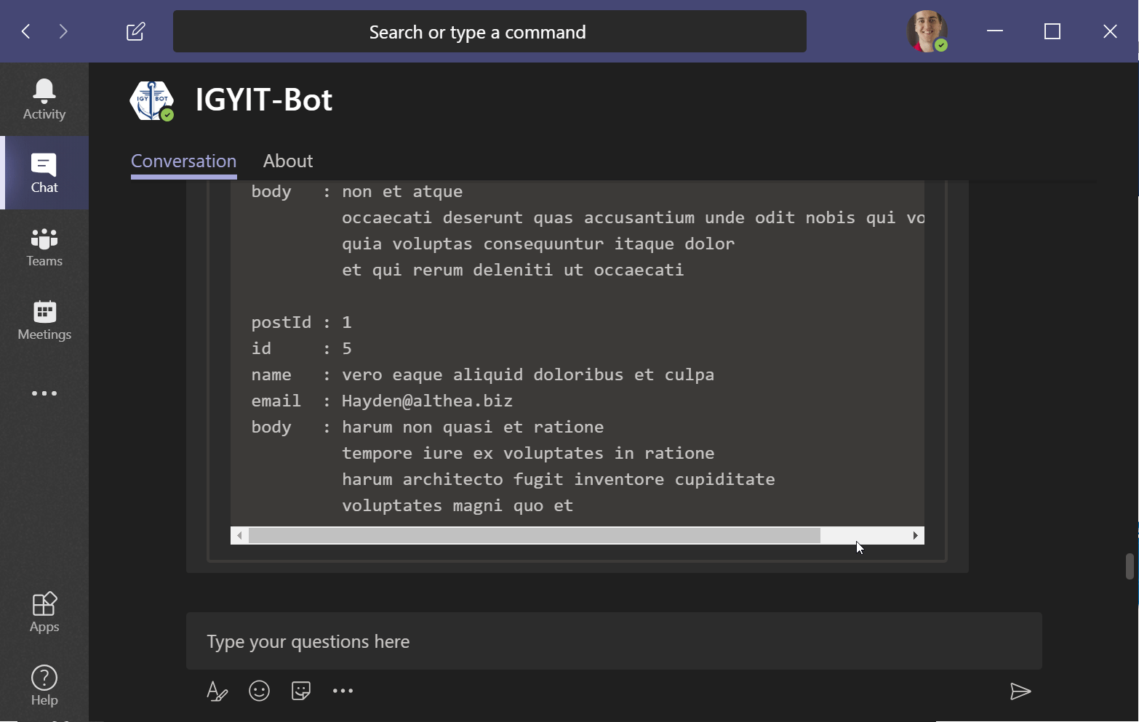
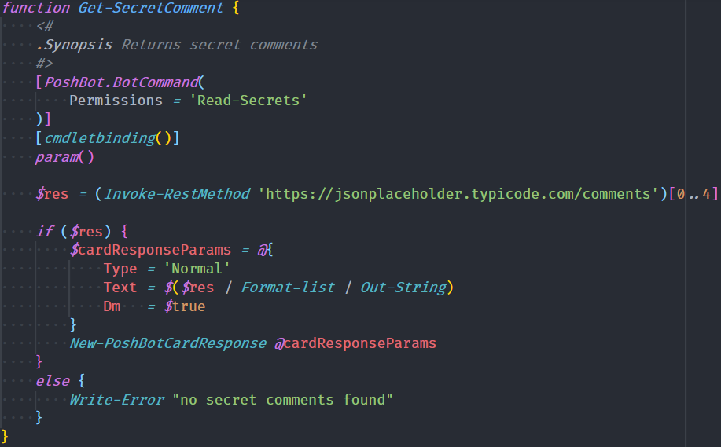
Results sent as dm

Slide 35
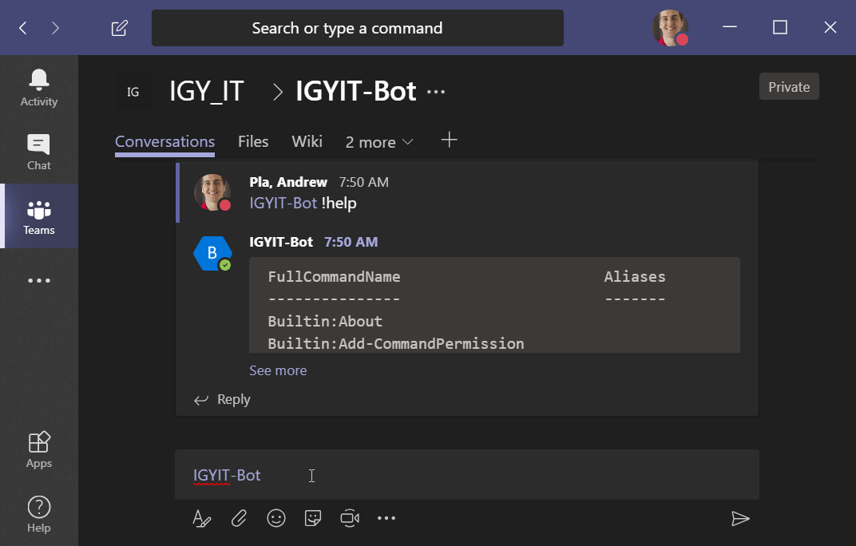
Create tickets
Notes:
Huge value for us.

Slide 36
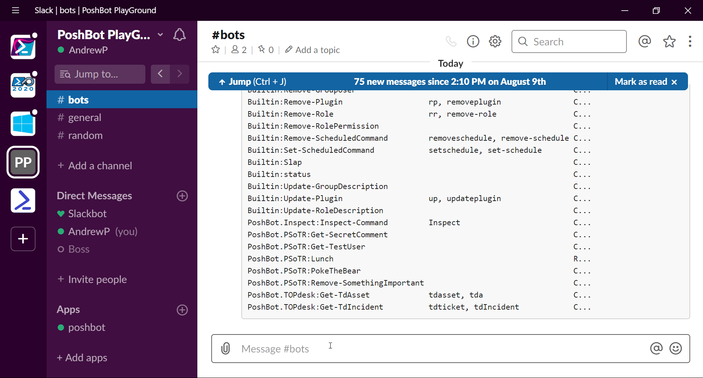
Invoke-ChocoPackage
Notes:
Example module that I wrote yesterday. If anyone is interested in helping me out and contributing to open source reach out to me.

Slide 37
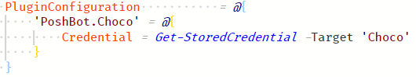
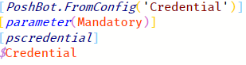
Providing Credentials
Set Credential in Bot Config
Get Parameter from Configuration
https://andrewpla.github.io/Writing-a-PoshBot-Plugin/
Notes:
This is inside the
PoshBot serializes these values encrypted to disc. Only the user that exported the credential can import it.
Useful so you can run poshbot unprivileged and give it the necessary credentials.
I wrote a blog post where I accept a few values from configuration

Slide 38
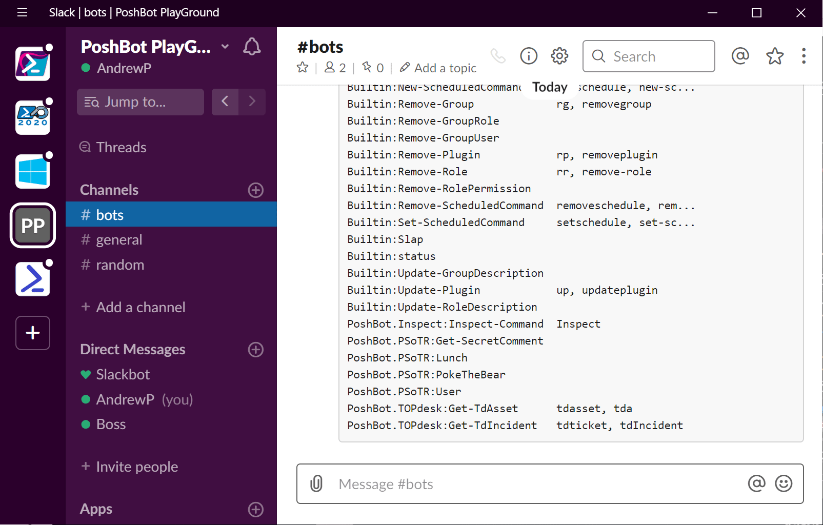
Command Approvals
Notes:
Time to poke the bear

Slide 39
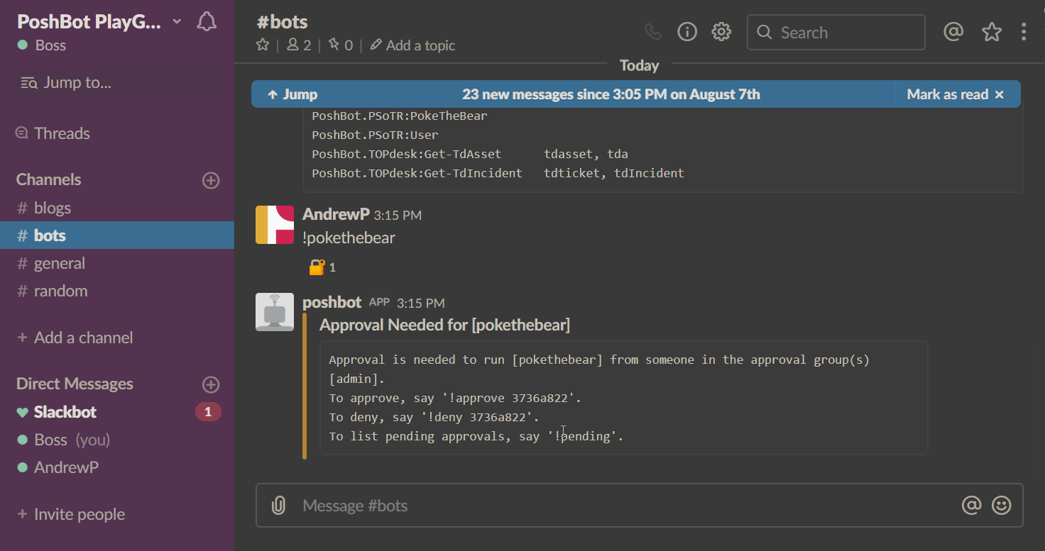
Command Approvals

Slide 40
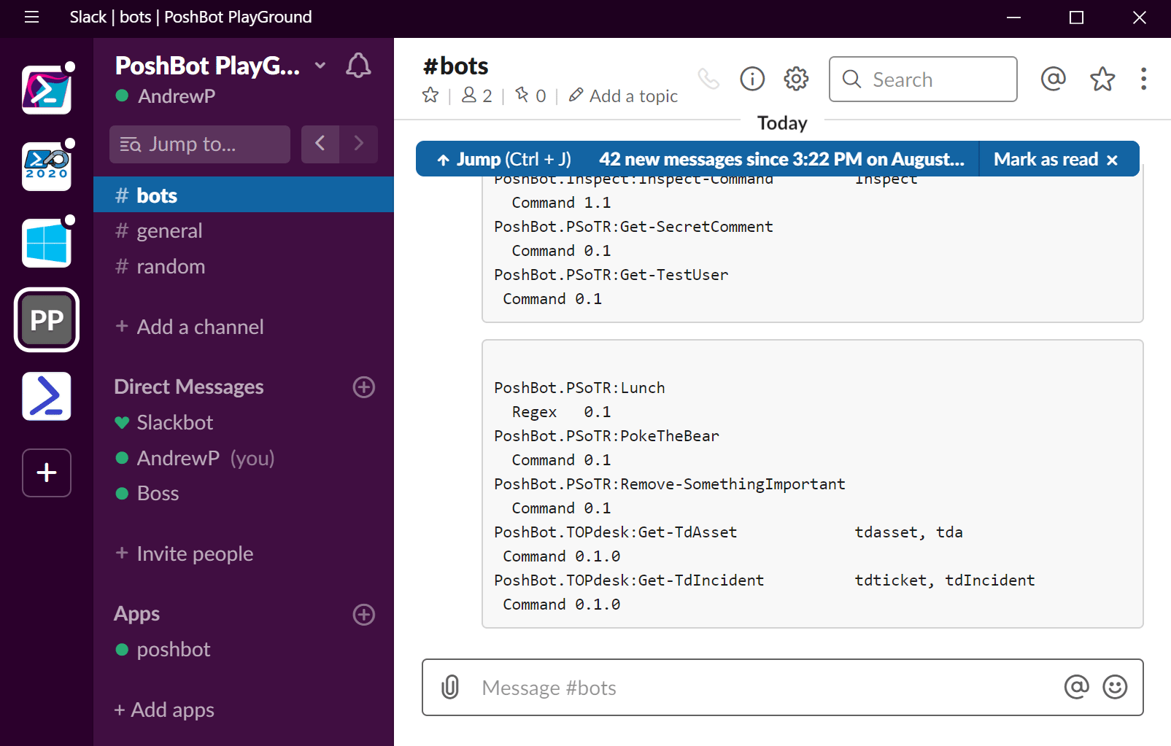

Be Forceful
Notes:
Use –Force to ensure safety.

Slide 41
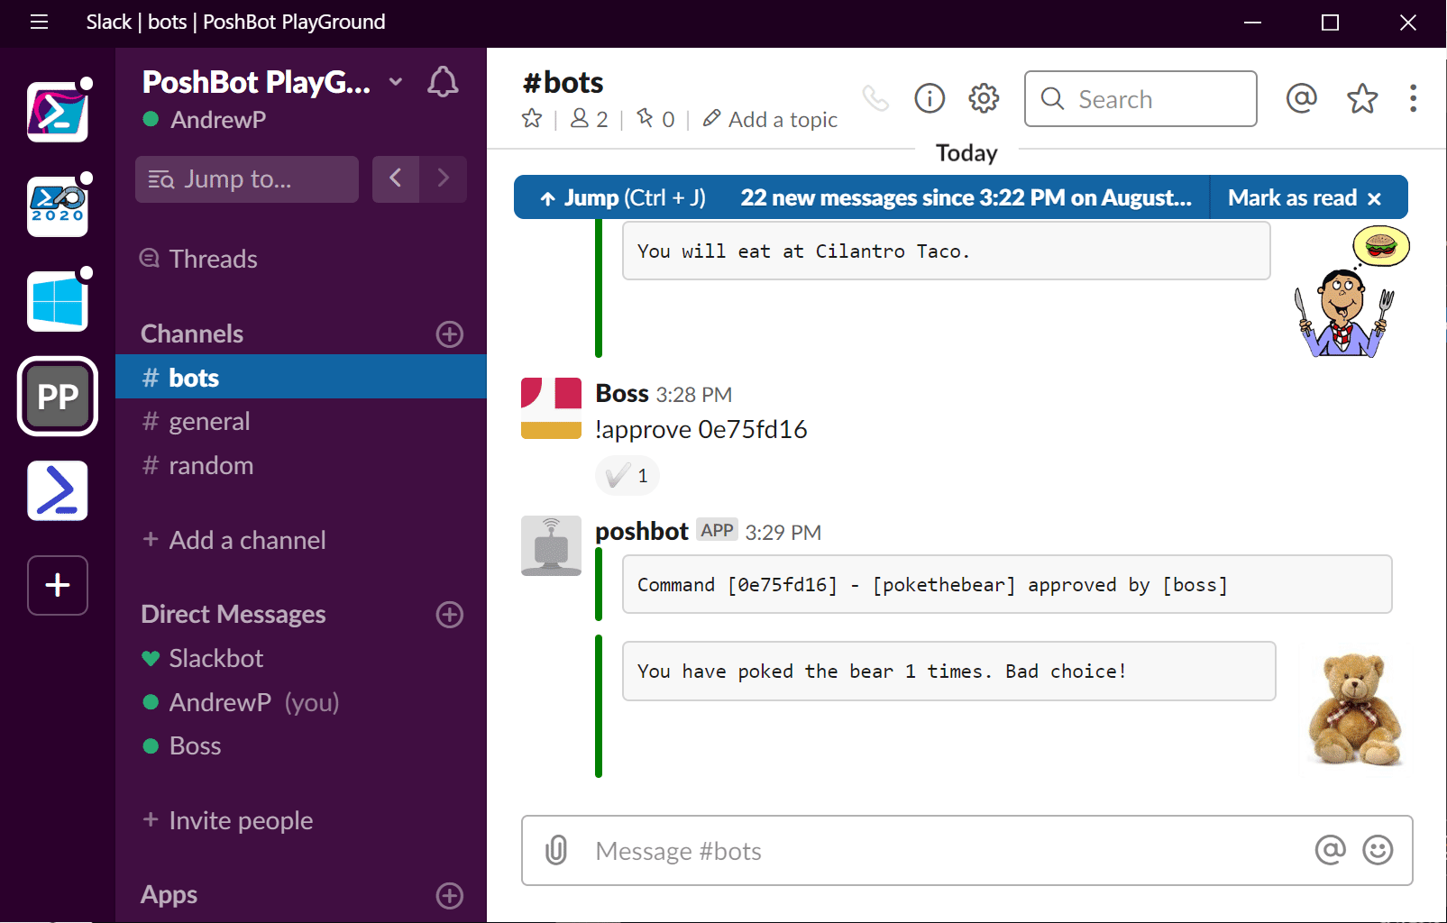
Command History
Notes:
Look at log file. C:\repos\chatops-presentation\CommandHistory.log
get-content 'C:\Repos\ChatOps-Presentation\logs\CommandHistory.log' |
ConvertFrom-Json |
Select-Object -last 2

Slide 42
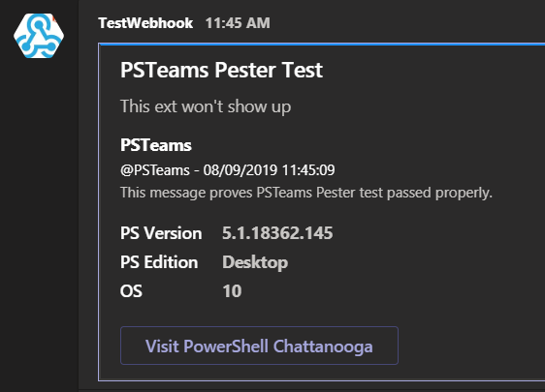
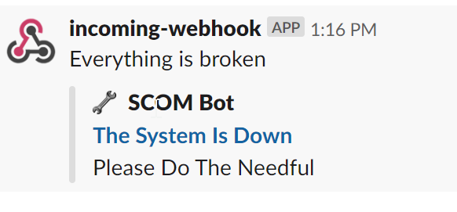
Teams Webhook

Slide 43


Steps to Chatops
Start small
Simple issues
Encourage your team
Make commands user friendly
Use the –Force
Demonstrate by doing (Be a champion!)
Bring in other people
It’s a marathon, not a sprint
Use webhooks/emails
Notes:
Set this up for yourself quickly using Slack. Invest in yourself and learn poshbot. Automate your home workflow.
It’s a very fun side project

Slide 44
Resources
https://andrewpla.github.io/Writing-a-PoshBot-Plugin/
https://ramblingcookiemonster.github.io/PSSlack/
https://blogs.technet.microsoft.com/stefan_stranger/2016/11/03/use-webhook-connector-to-send-data-from-powershell-to-microsoft-teams/

Slide 45
Thanks
https://github.com/poshbotio/PoshBot
https://leanpub.com/chatops-the-easy-way
https://github.com/AndrewPla
@AndrewPlaTech
Feedback is appreciated!

